Slide 1
Using Functions in Graphics
Notes:
Hi! In this lesson, we’re going to look at how functions can be used inside our programs to make them more efficient and easier to read.

Slide 2
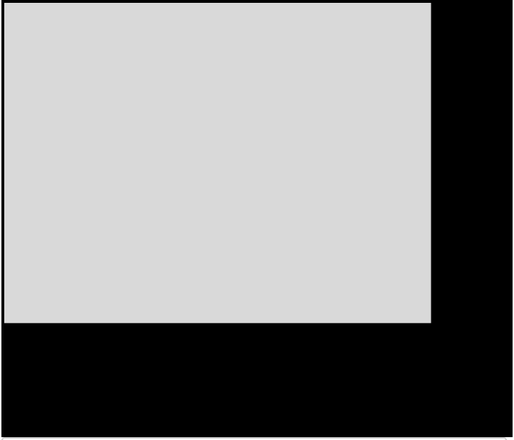
Functions in Python Graphics
from tkinter import *
root = Tk()
# Constant values
canvas_width = 400
canvas_height = 300
# Create canvas
screen = Canvas(root, width=canvas_width, height=canvas_height)
screen.pack()
def draw_circle(radius, color):
top_x = canvas_width/2 - radius
top_y = canvas_height/2 - radius
bottom_x = canvas_width/2 + radius
bottom_y = canvas_height/2 + radius
screen.create_oval(top_x, top_y, bottom_x, bottom_y, fill=color)
mainloop()
Notes:
Using functions in Python graphics is exactly the same as using them in our console programs! To define a function, we use the keyword ‘def’ and write the function name and any parameters followed by a colon. Indented inside we list all of the actions we want that function to complete and can use the parameter names to control different commands in our function, such as the color variable being used to control the fill color of the circle we’re drawing here.

Slide 3
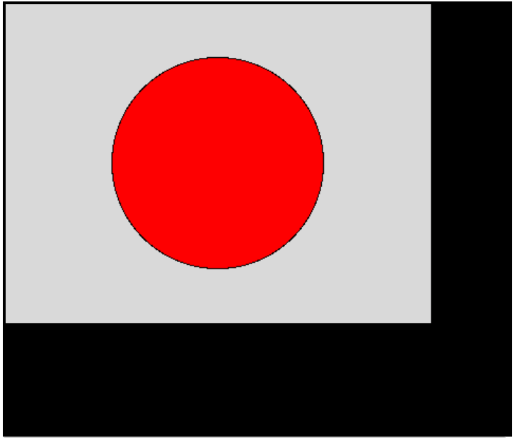
Functions in Python Graphics
from tkinter import *
root = Tk()
# Constant values
canvas_width = 400
canvas_height = 300
# Create canvas
screen = Canvas(root, width=canvas_width, height=canvas_height)
screen.pack()
def draw_circle(radius, color):
top_x = canvas_width/2 - radius
top_y = canvas_height/2 - radius
bottom_x = canvas_width/2 + radius
bottom_y = canvas_height/2 + radius
screen.create_oval(top_x, top_y, bottom_x, bottom_y, fill=color)
draw_circle(100, "red")
mainloop()
Notes:
To call our function, we simply write the function name and enter needed parameters inside parentheses.

Slide 4
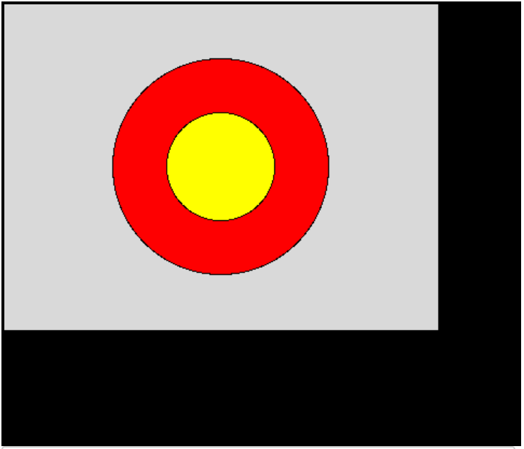
Functions in Python Graphics
from tkinter import *
root = Tk()
# Constant values
canvas_width = 400
canvas_height = 300
# Create canvas
screen = Canvas(root, width=canvas_width, height=canvas_height)
screen.pack()
def draw_circle(radius, color):
top_x = canvas_width/2 - radius
top_y = canvas_height/2 - radius
bottom_x = canvas_width/2 + radius
bottom_y = canvas_height/2 + radius
screen.create_oval(top_x, top_y, bottom_x, bottom_y, fill=color)
draw_circle(100, "red")
draw_circle(50, "yellow")
mainloop()
Notes:
We can call our functions as many times as we’d like to add multiple shapes to our canvas. Let’s take a look at an example to see this in action.

Slide 5
Balloons
To create needed shapes:
screen.create_oval(top left x, top left y, bottom right x, bottom right y)
screen.create_polygon(x1, y1, x1, y2, x3, y3, ...)
Constant Values:
canvas_height = 300
canvas_width = 400
balloon_height = canvas_height/4
balloon_width = canvas_height/5
balloon_tie_size = balloon_width/4
Notes:
We’re going to complete this exercise where we’re being asked to draw balloons to the screen using a function. The center and color of each balloon should be given to the function as parameters and the dimensions of the balloons should follow the constants laid out. Before we get to writing our program, let’s take a minute to plan.

Slide 6
Balloons
Constant Values:
canvas_height = 300
canvas_width = 400
balloon_height = canvas_height/4
balloon_width = canvas_height/5
balloon_tie_size = balloon_width/4
To create needed shapes:
screen.create_oval(top left x, top left y, bottom right x, bottom right y)
screen.create_polygon(x1, y1, x1, y2, x3, y3, ...)
Coordinate Points for Oval:
Top X:
Top Y:
Bottom X:
Bottom Y:
(x, y) of center given as parameters:
x: center_x
y: center_y
Notes:
Let’s first take a look at the oval of the balloon. We’ll need to find our coordinates for the top left and bottom right corners of the oval with the center of the circle given to us through parameters.

Slide 7
Balloons
Constant Values:
canvas_height = 300
canvas_width = 400
balloon_height = canvas_height/4
balloon_width = canvas_height/5
balloon_tie_size = balloon_width/4
To create needed shapes:
screen.create_oval(top left x, top left y, bottom right x, bottom right y)
screen.create_polygon(x1, y1, x1, y2, x3, y3, ...)
Coordinate Points for Oval:
Top X: center_x - balloon_width/2
Top Y:
Bottom X:
Bottom Y:
center_x - balloon_width/2
Notes:
To find the x coordinate of the top corner of our oval, we would start with the x-coordinate given as a parameter and subtract half of the width of the oval.

Slide 8
Balloons
Constant Values:
canvas_height = 300
canvas_width = 400
balloon_height = canvas_height/4
balloon_width = canvas_height/5
balloon_tie_size = balloon_width/4
To create needed shapes:
screen.create_oval(top left x, top left y, bottom right x, bottom right y)
screen.create_polygon(x1, y1, x1, y2, x3, y3, ...)
Coordinate Points for Oval:
Top X: center_x - balloon_width/2
Top Y: center_y - balloon_height/2
Bottom X:
Bottom Y:
center_y - balloon_height/2
Notes:
To find the y coordinate of the top corner of our oval, we would start with the y-coordinate given as a parameter and subtract half of the height of the oval.

Slide 9
Balloons
Constant Values:
canvas_height = 300
canvas_width = 400
balloon_height = canvas_height/4
balloon_width = canvas_height/5
balloon_tie_size = balloon_width/4
To create needed shapes:
screen.create_oval(top left x, top left y, bottom right x, bottom right y)
screen.create_polygon(x1, y1, x1, y2, x3, y3, ...)
Coordinate Points for Oval:
Top X: center_x - balloon_width/2
Top Y: center_y - balloon_height/2
Bottom X: center_x + balloon_width/2
Bottom Y: center_y + balloon_height/2
center_y + balloon_height/2
center_x + balloon_width/2
Notes:
To find the x and y coordinates of the bottom corner of our oval, we would just add half the height and width of the balloon to the x and y coordinates given as parameters.

Slide 10
Balloons
Constant Values:
canvas_height = 300
canvas_width = 400
balloon_height = canvas_height/4
balloon_width = canvas_height/5
balloon_tie_size = balloon_width/4
To create needed shapes:
screen.create_oval(top left x, top left y, bottom right x, bottom right y)
screen.create_polygon(x1, y1, x1, y2, x3, y3, ...)
Coordinate Points for Triangle:
Top X:
Top Y:
Right X:
Right Y:
Left X:
Left Y:
Notes:
For the balloon tie, we can use the create_polygon command to note the three points of the triangle we need to create. Let’s zoom in so we can figure out the coordinates for this shape.

Slide 11
Balloons
Constant Values:
canvas_height = 300
canvas_width = 400
balloon_height = canvas_height/4
balloon_width = canvas_height/5
balloon_tie_size = balloon_width/4
To create needed shapes:
screen.create_oval(top left x, top left y, bottom right x, bottom right y)
screen.create_polygon(x1, y1, x1, y2, x3, y3, ...)
Coordinate Points for Triangle:
Top X: center_x
Top Y:
Right X:
Right Y:
Left X:
Left Y:
center_x
Notes:
The x-coordinate for the top point of the triangle is just the center x value given by the user.

Slide 12
Balloons
Constant Values:
canvas_height = 300
canvas_width = 400
balloon_height = canvas_height/4
balloon_width = canvas_height/5
balloon_tie_size = balloon_width/4
To create needed shapes:
screen.create_oval(top left x, top left y, bottom right x, bottom right y)
screen.create_polygon(x1, y1, x1, y2, x3, y3, ...)
Coordinate Points for Triangle:
Top X: center_x
Top Y: center_y + balloon_height/2
Right X:
Right Y:
Left X:
Left Y:
center_y + balloon_height/2
Notes:
The y-coordinate for the top point of the triangle is the same as the bottom corner of our oval, so we’ll use center_y + balloon_height/2.

Slide 13
Balloons
Constant Values:
canvas_height = 300
canvas_width = 400
balloon_height = canvas_height/4
balloon_width = canvas_height/5
balloon_tie_size = balloon_width/4
To create needed shapes:
screen.create_oval(top left x, top left y, bottom right x, bottom right y)
screen.create_polygon(x1, y1, x1, y2, x3, y3, ...)
Coordinate Points for Triangle:
Top X: center_x
Top Y: center_y + balloon_height/2
Right X: center_x + balloon_tie_size/2
Right Y:
Left X:
Left Y:
center_x + balloon_tie_size/2
Notes:
To find the x-coordinate of the bottom right point, we’ll need to use the balloon_tie_size variable which controls both the height and width of the triangle. To get that x coordinate, we start with the center_x that the user has given and add half of the balloon_tie_size variable.

Slide 14
Balloons
Constant Values:
canvas_height = 300
canvas_width = 400
balloon_height = canvas_height/4
balloon_width = canvas_height/5
balloon_tie_size = balloon_width/4
To create needed shapes:
screen.create_oval(top left x, top left y, bottom right x, bottom right y)
screen.create_polygon(x1, y1, x1, y2, x3, y3, ...)
Coordinate Points for Triangle:
Top X: center_x
Top Y: center_y + balloon_height/2
Right X: center_x + balloon_tie_size/2
Right Y: center_y + balloon_height/2 + balloon_tie_size
Left X:
Left Y:
center_y + balloon_height/2 + balloon_tie_size
Notes:
For the y variable, we’ll need to start with the center y given from the user and add half the balloon_height which gets to the top of the triangle. Then we need to also add the full value of the balloon_tie_size variable to get all the way to the bottom of the triangle.

Slide 15
Balloons
Constant Values:
canvas_height = 300
canvas_width = 400
balloon_height = canvas_height/4
balloon_width = canvas_height/5
balloon_tie_size = balloon_width/4
To create needed shapes:
screen.create_oval(top left x, top left y, bottom right x, bottom right y)
screen.create_polygon(x1, y1, x1, y2, x3, y3, ...)
Coordinate Points for Triangle:
Top X: center_x
Top Y: center_y + balloon_height/2
Right X: center_x + balloon_tie_size/2
Right Y: center_y + balloon_height/2 + balloon_tie_size
Left X: center_x - balloon_tie_size/2
Left Y:
center_x - balloon_tie_size
Notes:
For the final point of our triangle, we’ll need to start with the x value of the balloon center and subtract half of the balloon_tie_size variable.

Slide 16
Balloons
Constant Values:
canvas_height = 300
canvas_width = 400
balloon_height = canvas_height/4
balloon_width = canvas_height/5
balloon_tie_size = balloon_width/4
To create needed shapes:
screen.create_oval(top left x, top left y, bottom right x, bottom right y)
screen.create_polygon(x1, y1, x1, y2, x3, y3, ...)
Coordinate Points for Triangle:
Top X: center_x
Top Y: center_y + balloon_height/2
Right X: center_x + balloon_tie_size/2
Right Y: center_y + balloon_height/2 + balloon_tie_size
Left X: center_x - balloon_tie_size/2
Left Y: center_y + balloon_height/2 + balloon_tie_size
center_y + balloon_height/2 + balloon_tie_size
Notes:
And the y value of this point will be the exact same as it was in the previous point! Now let’s go to the editor.

